Slide 1
Lending Club case study
Authors
Anil Kumar Sasi
Venu Madhav Kolloju
Date: 06th Mar 2024

Slide 2
Introduction
Lending Club is the largest online loan marketplace, facilitating personal loans, business loans, and financing of medical procedures. Borrowers can easily access lower interest rate loans through a fast online interface.
Like most other lending companies, lending loans to ‘risky’ applicants is the largest source of financial loss (called credit loss). Credit loss is the amount of money lost by the lender when the borrower refuses to pay or runs away with the money owed. In other words, borrowers who default cause the largest amount of loss to the lenders. In this case, the customers labelled as 'charged-off' are the 'defaulters'.

Slide 3
Objective
The purpose of this case study is to understand and identify potential risky loan applicants, so that loan applications from such applications can be rejected and thereby cutting down the amount of credit loss incurred by charged off loans.
In the coming slides we will showcase our analysis of the data provided by Lending Club, that has the details of all loans issued from 2007 till 2011.

Slide 4
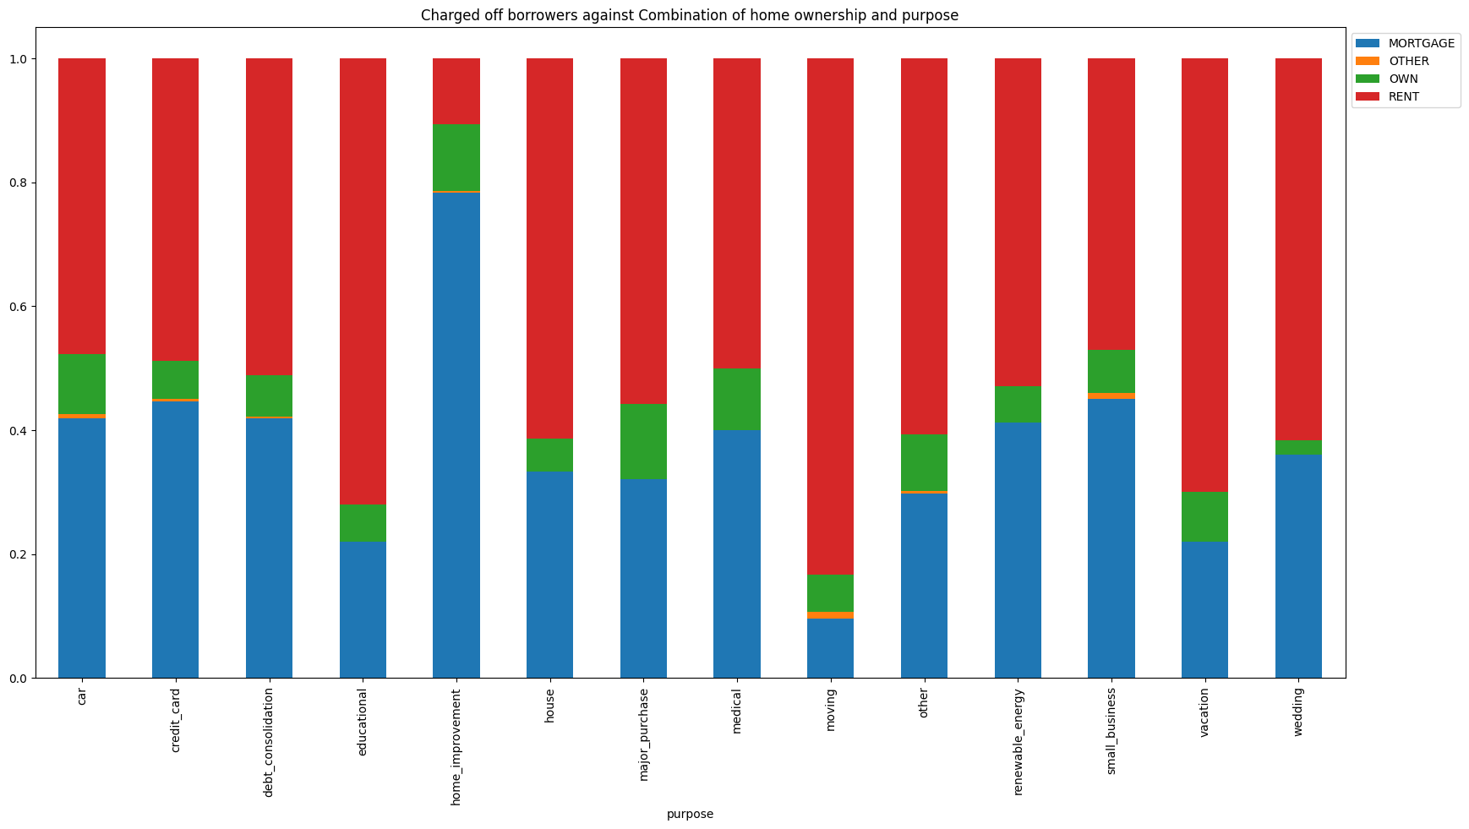
Analysis
Charged Off Borrowers against Home ownership and Purpose
Upon analysing the data of charged off borrowers against the home ownership and purpose, we observe borrowers with below traits are potential defaulters
Borrowers who are on rent and taking educational loan
Borrowers who take home improvement on mortgaged property
Borrowers who are moving/relocating and are on rent

Slide 5
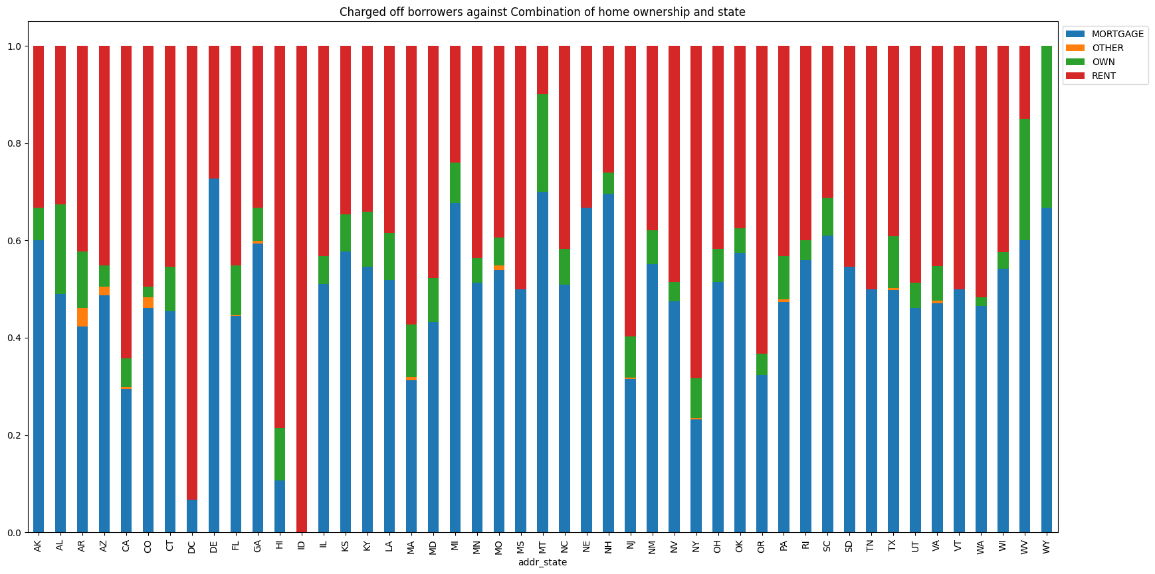
Analysis
Charged Off Borrowers against residential State and home ownership
Upon analysing the data of charged off borrowers against the home ownership and state of residence, we observe borrowers with below traits are potential defaulters
Borrowers who are on rent and in states ID, DC and HI
Borrowers whose property is on mortgage and the property is in states DE, MI, MT, NE, NH, WV and WY

Slide 6
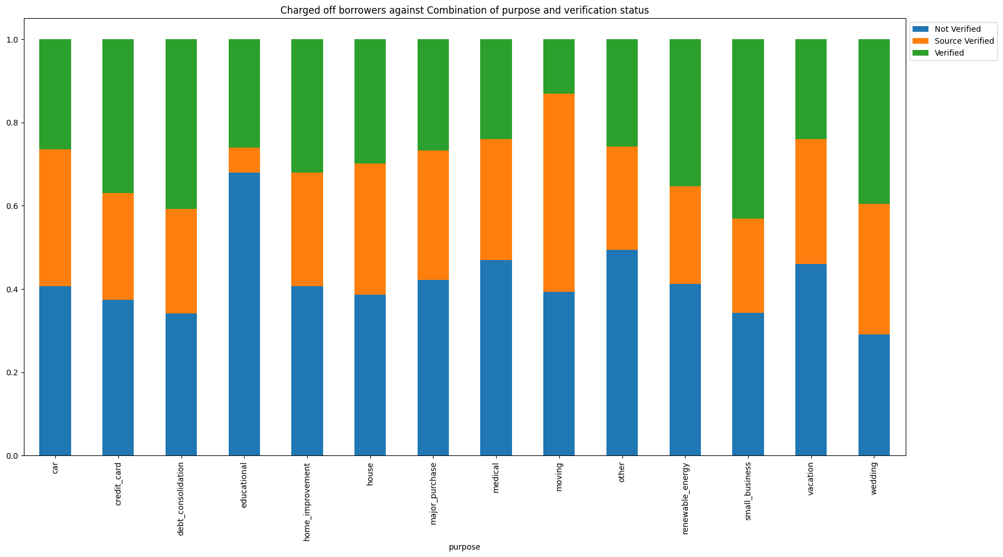
Analysis
Charged Off Borrowers against purpose and verification status
Upon analysing the data of charged off borrowers against the purpose of loan and verification status, we observe borrowers with below traits are potential defaulters
Borrowers who are not verified and take educational loan
Borrowers who are source verified and taking loan for moving

Slide 7
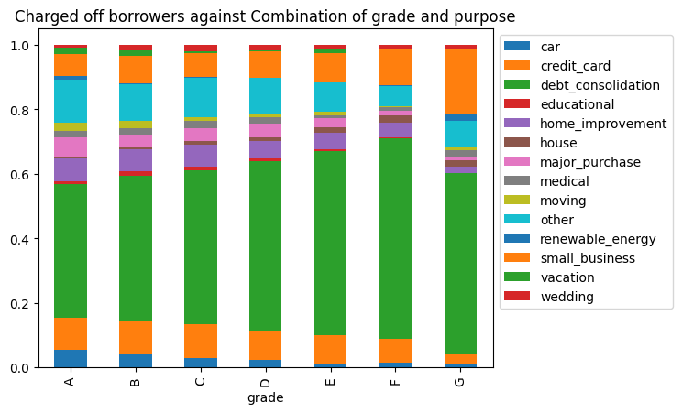
Analysis
Charged Off Borrowers against purpose and grade
Upon analysing the data of charged off borrowers against the purpose of loan and grade of the borrower, we observe borrowers with below traits are potential defaulters
Borrowers whose loan purpose is debt consolidation and the probability increase as the grade gets poor.
Borrowers who use credit card and the probability increase as the grade gets poor.
Note: Interestingly Borrowers whose loan purpose is small business, their probability of repaying increase as the grade gets poor.

Slide 8
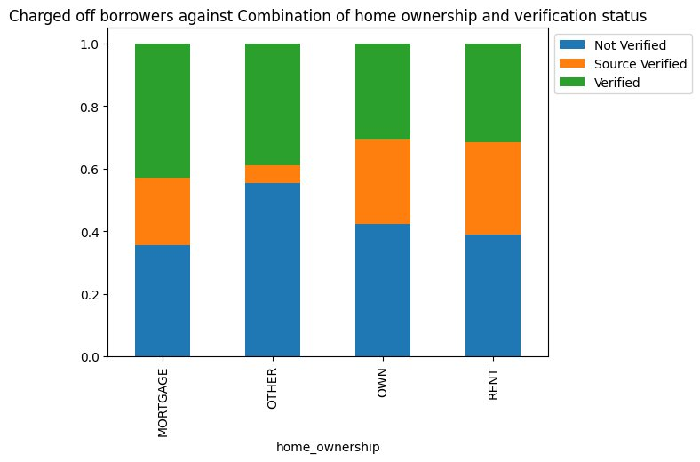
Analysis
Charged Off Borrowers against Home ownership and Verification Status
Upon analysing the data of charged off borrowers against the home ownership and verification status of the borrower, we observe borrowers with below traits are potential defaulters
Borrower with Verification status as "Not Verified" and the home ownership as "Others" are potential defaulters.

Slide 9
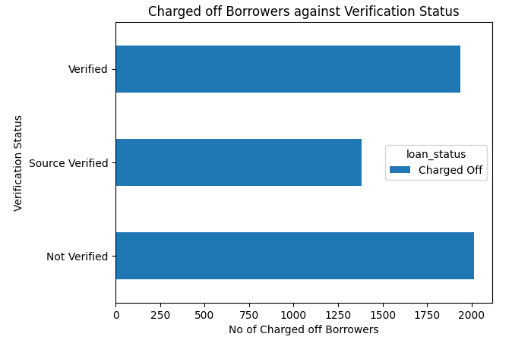
Analysis
Charged Off Borrowers vs Verification Status
Upon analysing the data of charged borrowers against the Verification status, we can see that the over all number of defaulted loans is not affected by the fact whether the borrowers source of income was verified or not.

Slide 10
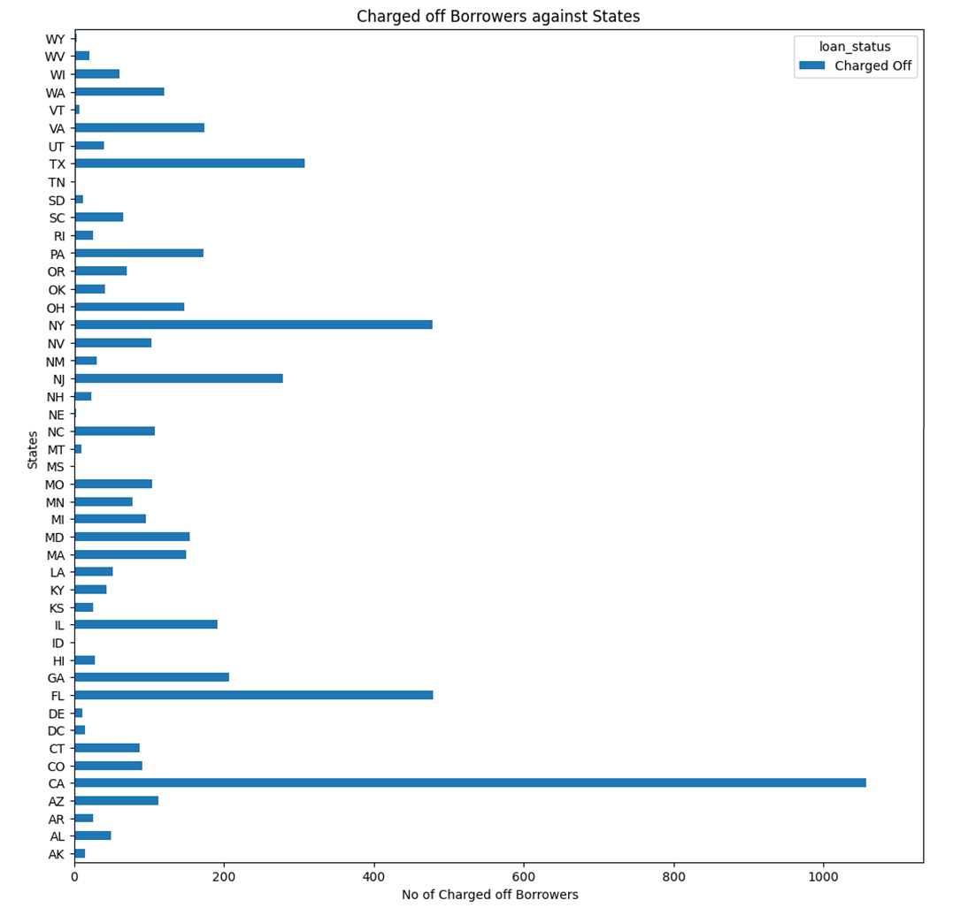
Analysis
Charged Off Borrowers vs their State of residence
Upon analysing the data of charged borrowers against the states from where they are, we can see that the overall number of defaulters is quite high in the states of CA, FL and NY.

Slide 11
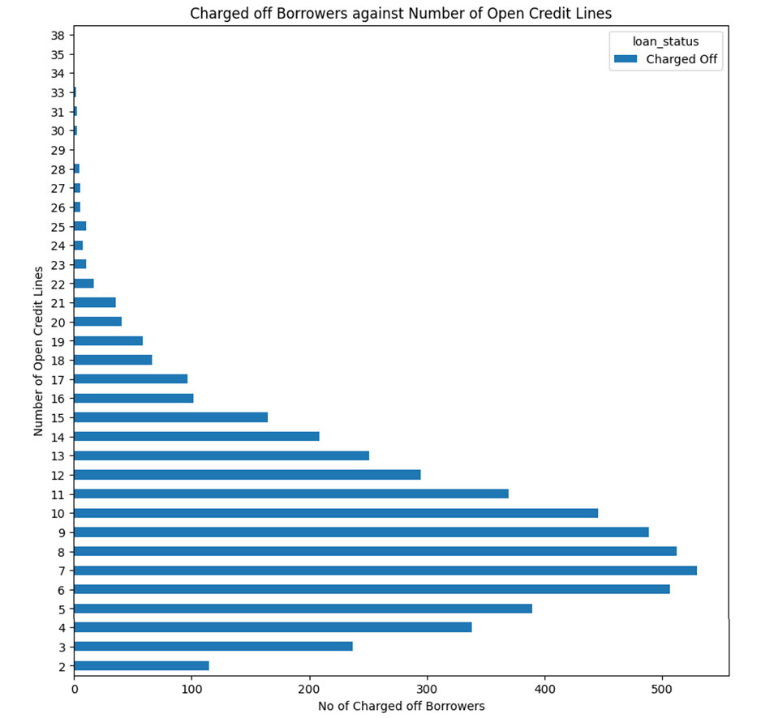
Analysis
Charged Off Borrowers vs Number of Open Credit Lines
Upon analysing the data of charged borrowers against the Verification status, we can see that the number of defaulter is highest for borrowers who have 7 open credit lines, and over all borrowers with 3 to 13 open credit lines have the most defaulters.

Slide 12
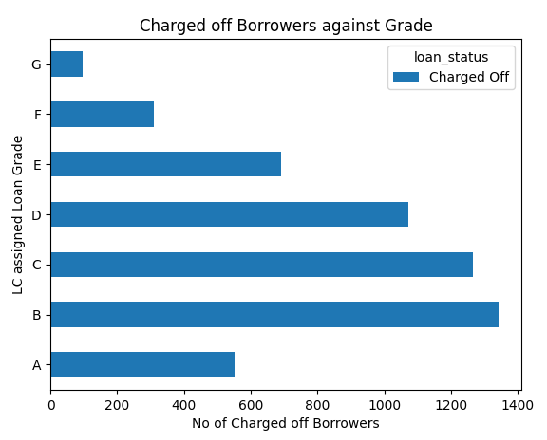
Analysis
Charged Off Borrowers vs Grade
Upon analysing the data of charged borrowers against the Grade, we can see that the number of defaulter is highest for borrowers who have grades B, C, D and E.

Slide 13
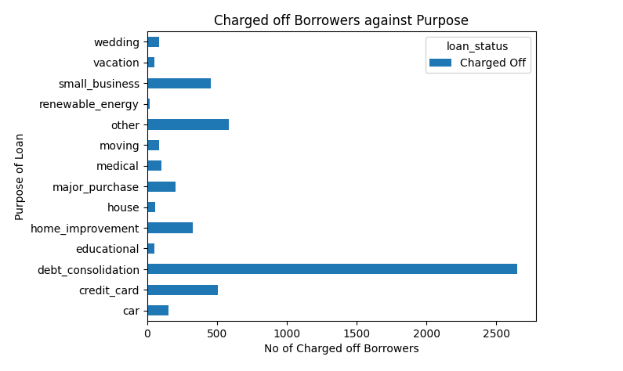
Analysis
Charged Off Borrowers vs Purpose of the loan
Upon analysing the data of charged borrowers against the Verification status, we can see that the over largest number of defaulters have taken loans for debt consolidation

Slide 14
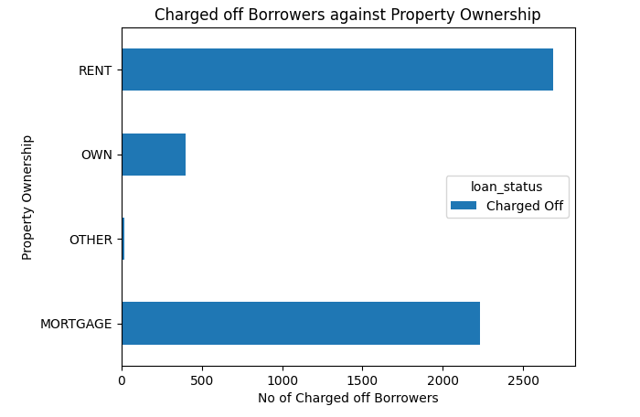
Analysis
Charged Off Borrowers vs Property Ownership
Upon analysing the data of charged borrowers against the Verification status, we can see that the greatest number of defaulters live either rented or mortgage houses.

Slide 15
Conclusion
After analysis some of the major factors in the data provided. We can provide the following suggestions to Lending Club, to help them approve or reject forthcoming loan applications
Borrowers whose loan purpose is small business, their probability of repaying increase as the grade gets poor.
Restrict the number of loans provided to people from the states CA, FL and NY.
Double verify when the borrowers are on rent and in states ID, DC and HI
Borrowers whose property is on mortgage and the property is in states DE, MI, MT, NE, NH, WV and WY
Have more credit history investigations before providing loans to people who have 3 to 13 open credit lines
Have additional screening of applications if the grading is B, C, D or E.
Stop or reduce the number of loans taken for the purpose of debt consolidation
Avoid giving loans to people who have rented, or mortgage houses and loan purpose is education, home improvement and moving.

